Slide 1
The WMG - YTU Programme

Slide 2
Professional Programmes
High-quality, High-impact courses delivered by WMG in the UK and internationally
Designed for high-potential employees
Designed to be adaptable to meet the needs of the business and employee

Slide 3
Our Collaborative Concept
Companies and WMG are jointly responsible for:
  Strategic direction
  Range of taught modules
  Contents of each module
  Teaching methods
  Participant and lecturer assessment
Company staff and specialist consultants make a significant contribution to delivery

Slide 4
Overall Objectives of Programmes
Transfer knowledge to the workplace
Improve the capability of the employee and their effectiveness
  Improve the capability and performance of the company

Slide 5
Example Programmes - 1
BAE Systems
    5 modules, 1100 staff, over 10 years
    Academic and professional accreditation.
    350m YTL savings identified by the business
Astra Zeneca
    6 modules, 20+ students per year
    Individuals from 27 countries to Warwick
    Supplier Professionalism Programme
    Opened to other pharmaceutical companies
Ministry of Defence - Equipment & Support
    3 to 6 modules, 45 students
    Now delivered to Malaysian Defence Industry

Slide 6
Example Programmes - 2
SAFEA - 5 modules plus, 100 students per year
    partly in Wuhan, China and partly in WMG, UK
    Certificate in Engineering Business Management
    Growing variety of offerings e.g. BJAST
Bharat Forge - full Masters degree
    3 year rolling program
    Approx. 100 students currently from Germany, India and USA.
CII – 10 modules and project, full Masters degree
    3 year rolling programme
    Approx. 100 students currently e.g. Larson & Toubro, TVS Motors

Slide 7
Technology R&D Management
Programme is designed to enable the development of R&D personnel for technology enabled organisations
Will create the capability to lead and manage R&D
A 6 module programme leading to Warwick Postgraduate Certificate
For current staff taken over 12 months
For newly recruited Research Engineers taken over 6 months

Slide 8
Our Modular Approach
Modules
One week - 40 hours
Intensive Delivery
Normal class size: 20 -30 students
No examination
Post module assignment
60 hours individual study
Industry focused
Embedding learning in company
3000 - 4000 words
Submitted by six weeks after end of module

Slide 9
Qualifications Route
3 Modules
Postgraduate
Award
Good Undergraduate Degree
English Competence
+ 3 Modules
Postgraduate
Certificate
+ 3 - 4 Modules + Dissertation
Masters

Slide 10
Current Modules
Business Modules
Business Awareness
Commercial & Industrial Law
International Joint Ventures
Managerial Accounting & Control Systems
Strategic Marketing
Business Policy & Strategic Management
E-Commerce
Financial Analysis & Control Systems
Financial Decision Making
Global Business Environment
Global e-Business
Legal Aspects of Global Business
Management of Change
People in Organisations
Operations Modules
Design Management
Improving Business Performance
Improving Manager Performance
Industrial Engineering
Logistics Planning
Process Analysis
Process Improvement
Project Planning, Management and Control
Quality Management
Manufacturing Planning & Control
Manufacturing Process Capability
Supply Chain Management
Total Productive Maintenance
Working in Teams
Applied Statistical Methods
Business and Operations Design
Collaborative Product Development
Creating Business Excellence
Design for the Environment
Improving Personal Performance
Innovation Strategy
Knowledge-based Asset Management
Leadership
Leadership & Excellence
Lean Principles & Application
Logistics & Operations Management
Managing the Multi-Project/Programme Environment
Operations Strategy for Industry
Process Improvement Using Six Sigma
Procurement & Inventory Management
Product Design & Development Management
Product Excellence Using Six Sigma
Quality Management and Techniques
Robust Design & Development
Simulation of Production Operations
Storage & Warehousing Techniques
Technology Management
Technology Modules
Dimensional Management
Information Technology
Process Modelling
Advanced Materials & Processes
Automation and Robotics
Enterprise Information Systems
Information & Communication Technologies
Machining Technologies
Manufacturing Process Technologies
Manufacturing Technology
Materials Engineering
Packaging
Transport Techniques & Management

Slide 11
Potential Modules for New Programme
Business Modules
One From:
Financial Analysis &
Control Systems
Management of Change
Operations Modules
Five From:
Project Planning, Management
and Control
Collaborative Product Development
Innovation Strategy
Managing the Multi-Project /
Programme Environment
Operations Strategy for Industry
Process Improvement Using Six
Sigma
Product Design & Development
Management
Technology Management

Slide 12
Potential Masters by subsequent study
Engineering Business Management
e-business Management
Innovation and Entrepreneurship
International Technology Management
Management for Business Excellence
Manufacturing Systems Engineering
Process Business Management
Programme and Project Management
Service Design and Management
Supply Chain and Logistics Management
Cybersecurity and Management
Digital Healthcare

Slide 13
Further Information:
www.wmg.warwick.ac.uk

Slide 14
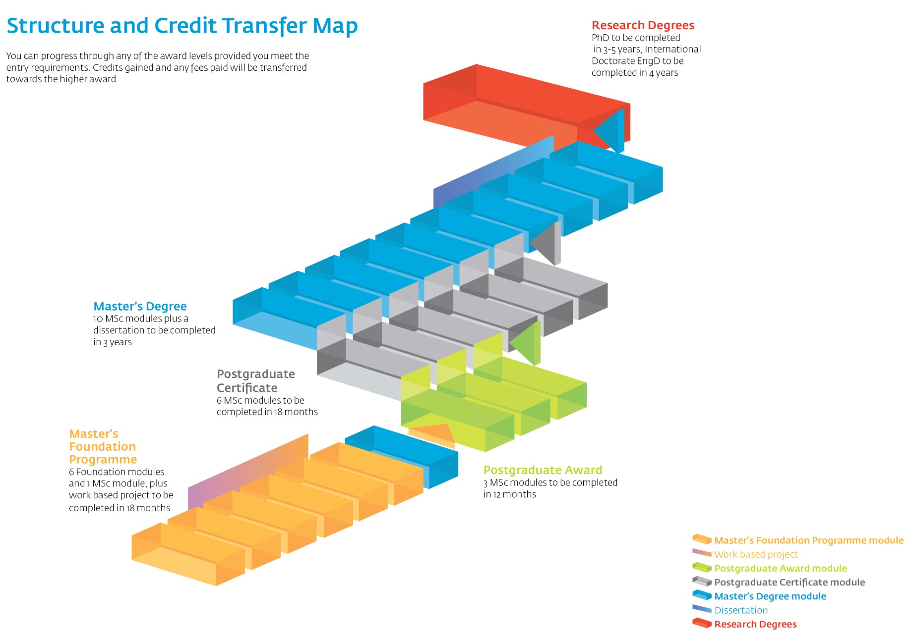
Integrated Development

Slide 15
Professional Programmes
Post-experience Route
Entry
No. of 2.5 day modules + project
Experience
8 + Project
Post-experience
Certificate
7 + Project
Post-experience
Diploma
Number of 5 day modules
Bridge
Number of 5 day modules
Postgraduate Route
7
Entry
Degree/HND/HNC
Post Experience Certificate
Relevant Experience
Postgraduate
Award
Postgraduate
Certificate
Masters
Degree
PhD/EngD
Research
Degree
3
3
6 + Dissertation
Supply Professionalism Programme
Dissertation
Entry
Degree/HND/HNC
Post Experience Certificate
Relevant Experience
Completion of dedicated SPP, 8 + Project
Postgraduate
Certificate

